Slide 1
Magnetism and The Derivation of Force
As Found by: William Poole

Slide 2
Solenoids and Force
The reason solenoids build up speed is the due to magnetic attraction. This attraction is the acceleration applied to the projectile and is influenced by 2 things:
Solenoid {Magnetic Flux due to operation}
Projectile {Material properties [magnetic moment]}

Slide 3
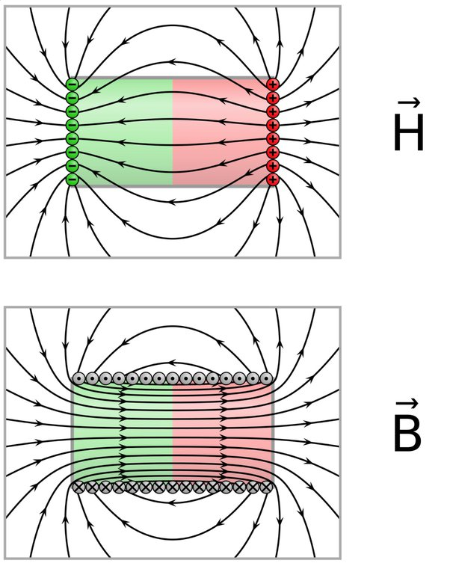
Magnetic Flux
According to a couple sources this is a measure of field passing through an area
B=“Magnetic Flux”
H=“Magnetic Field Intensity” pg 179 4-1
[Weird here] B=uH, u=“magnetic permeability” (Of material) u=u_k * u_0
Magnetic Vector Potential: A
Inductance: L

Slide 4
Magnetic Force
F_m =Q(V x B) [N] {x is cross product vector}
Q: is charge unit [Columb]
V: is velocity [meters/second] {m/s}
B: magnetic flux unit is N*s/Q*m-> N/Am
Amp/current: C/s [A/I]
*Of note chapter 5-1 page 237 states magnetic force is always perpendicular to velocity
F_e=q*E (charge multiplied with electric field [E])

Slide 5
Magnetic Force
Equations 5.7-5.11 result in the understanding that magnetic force
F_m=I LxB
I current
L path of current
B magnetic field

Slide 6
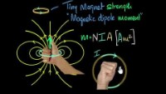
Generating Magnetic Force
Referring to right hand rule one could think about an electron spinning around to generate a magnetic dipole
Referring to Biot-Savart Law
H=(I/4*pi)(derivative(length of path) x radius vector)/|radius^2|
5.21 pg 244

Slide 7
Force Comprehension
Assuming using non-magnetized core/projectile
There are magnetization fields in object non-parallel to each other which will experience only magnetic torques at the start.
Once the torques begin magnetostatics do not apply as now we have time-varying fields, induced EMFs and more.

Slide 8
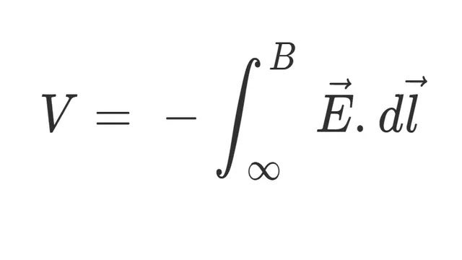
New terminology
Phi [Φ] is the integral of B across a surface
V_emf=-N(d Φ/dt)=-N(d/dt)
E [Electric field intensity]
D [Flux density]
V_emf=V_tr.emf+V_m.emf tr[transformer] m [motion]
V_m.emf =0 [stationanry]
V_tr.emf=0 [if B is static] |v_tr.emf=integral closed loop {E dl} pg285
F=q*e

Slide 9
Seperator

Slide 10
Knowns now
As a solenoid turns on it generates magnetic flux [B]
EQ 5.89 pg 266
As any loop {current carrier} receives a time varying field [Note planning on recognizing inertial reference frames. It generates a voltage around the loop.
Eq 6.8 PG 284
Note with Qv x B =F_m and F_e=QE
Magnetic forces will toss the charge to alignment
Electric forces will push along a gradient of voltage

Slide 11
From Solenoid equations
6.10 V.tr_emf=integral of closed contour {E}
6.11 integral of closed contour {E}=integral of surface {-d[B]/dt}
Earlier F=q*E
From figures 6-2 and 6-3 we can see that the voltage induced is in the path of the loop which accelerates electrons F_e=QE
Also that the velocity is accelerating we get F_m=q V x B which means as the charges accelerate the force increases.

Slide 12
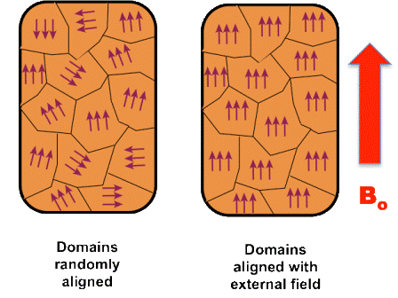
Magnetic Domains to Explain field alignment
https://en.wikipedia.org/wiki/Magnetic_domain
Note from Biot-Savart Law 5.21
We can determine that the current is
Rotating around the B0 vector

Slide 13
Force Generation Theory
Since electrons are orbiting the B0 axis
We can visualize what axis b0 is and the electrons orbit
However due to changing magnetic field we get v.tr_emf based on the changing B field. This causes electro motive force [V] along the B field.

